Slide 1
P8 - University of Novi Sad
Faculty of Technical Sciences
Igor Peško
University of Novi Sad, Faculty of Technical Sciences
Vesna Mašulović
University of Novi Sad
Kick – off meeting / 20.12.2018
This project has been funded with support from the European Commission. This publication reflects the views only of the author, and the Commission cannot be held responsible for any use which may be made of the information contained therein.

Slide 2
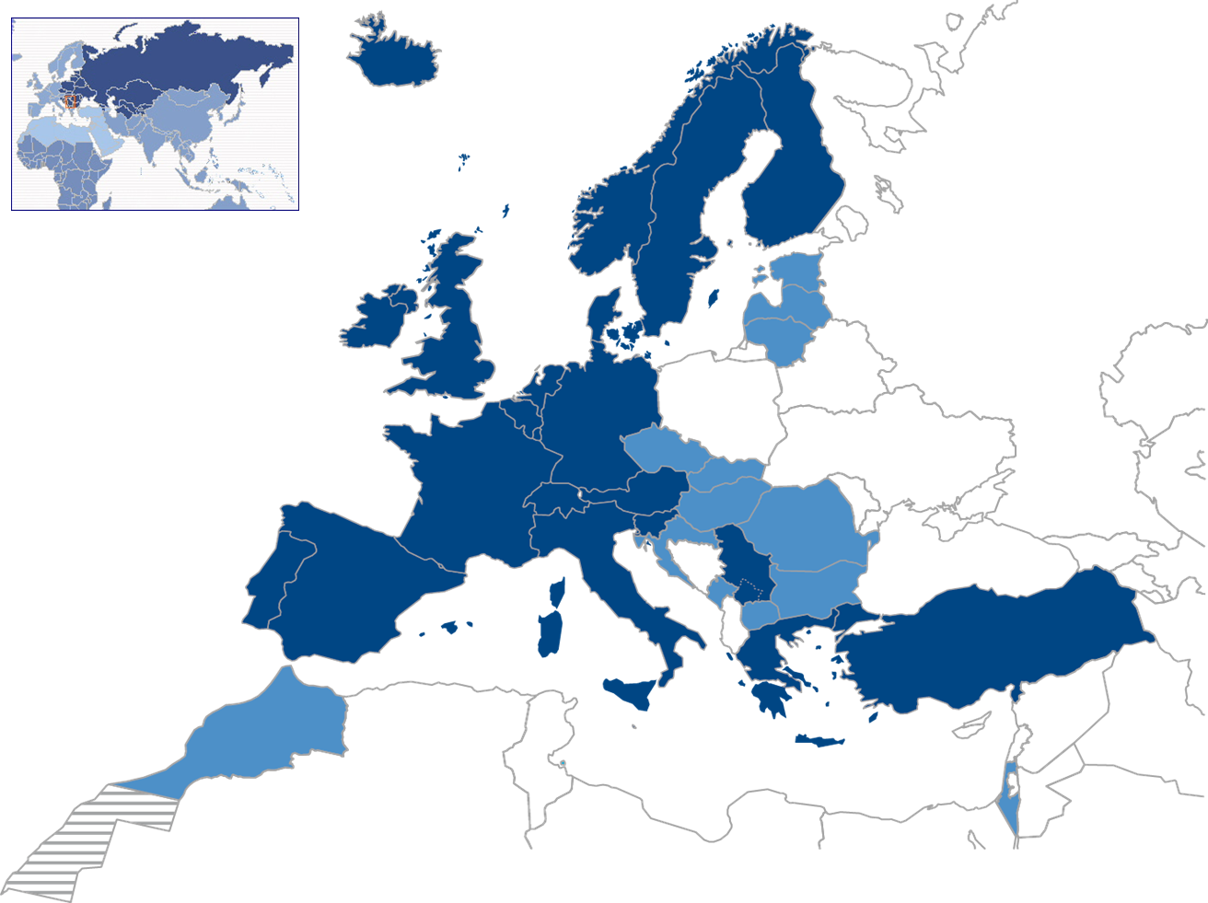
GENERAL INFORMATION
Location
GPS coordinates
45.247485 E
19.853974 N
Strengthening of master curricula in water resources management
for the Western Balkans HEIs and stakeholders
www.swarm.ni.ac.rs

Slide 3
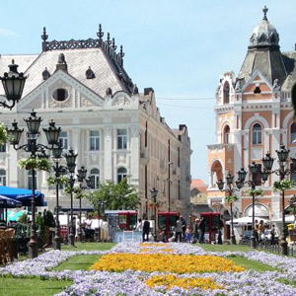
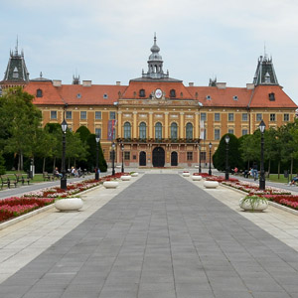
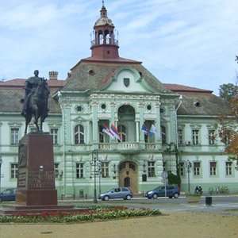
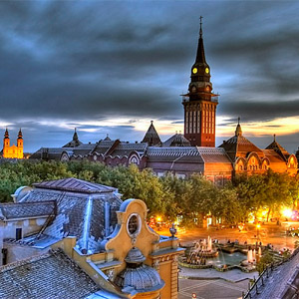
UNIVERSITY CITIES
The University of Novi Sad, founded in 1960, connects four historic cities of the Autonomous Province of Vojvodina, in the north of the Republic of Serbia:
NOVI SAD
SOMBOR
SUBOTICA
ZRENJANIN
Strengthening of master curricula in water resources management
for the Western Balkans HEIs and stakeholders
www.swarm.ni.ac.rs

Slide 4
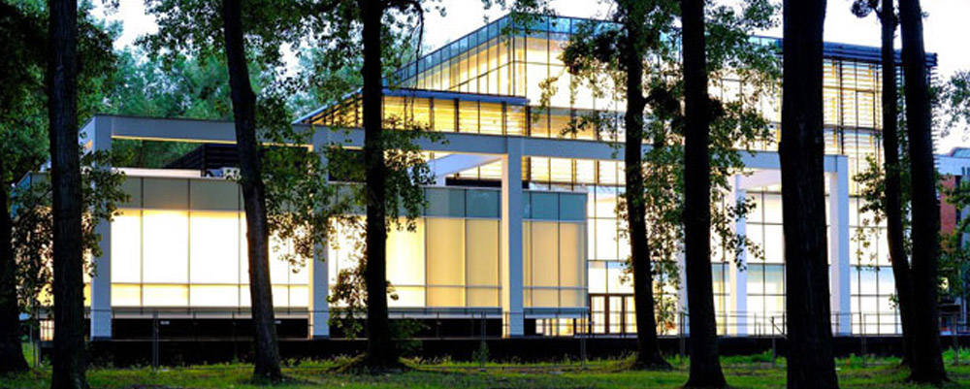
AMONG THE BEST IN THE WORLD
Among the top one thousand universities in the world according to the Webometrics Ranking of World Universities (July 2016): ranked 886th (competing with 24,000 universities), 389th in Europe (competing with 6,023 universities) and 38th in the area of Central and Eastern Europe (competing with 3,039 universities).
Ranked 756th among the 842 best universities in the world according to the CWTS Leiden Ranking (2016).
Among the 200 and 300 best ranked universities in Agriculture & Forestry on the 2017 list of QS World University Rankings by Subject.
Among the top 150 universities in the world in the field of Food Science and Technology, among the top 300 in the field of Sport and among the top 500 in the field of Mathematics on the Shanghai Ranking's Global Ranking of Academic Subjects in 2017.
Strengthening of master curricula in water resources management
for the Western Balkans HEIs and stakeholders
www.swarm.ni.ac.rs

Slide 5
GENERAL INFORMATION
Alliance of State Universities of the Republic of Serbia: the Presidency and the Headquarters are located at the University of Novi Sad
Doctoral School of Mathematics of the Republic of Serbia: the Presidency and the Headquarters are located at the University of Novi Sad
Confucius Institute of the University of Novi Sad, since 2014
Strengthening of master curricula in water resources management
for the Western Balkans HEIs and stakeholders
www.swarm.ni.ac.rs

Slide 6
GENERAL INFORMATION
One of the largest educational and research centres in Central Europe.
50,897 students
42,100 – I level of studies (Undergraduate and Integrated Academic Studies)
6,445 – II level of studies (Master and Specialist studies)
2,352 – III level of studies (Doctoral studies)
4,901 staff
3,502 teachers, associates and researchers
1,313 administrative staff
68 teachers and associates from abroad
373 study programmes
Strengthening of master curricula in water resources management
for the Western Balkans HEIs and stakeholders
www.swarm.ni.ac.rs

Slide 7
GENERAL INFORMATION
Comprehensive University
ENGINEERING AND TECHNOLOGY
NATURAL SCIENCES
SOCIAL SCIENCES AND HUMANITIES
ARTS
MEDICAL SCIENCES
Strengthening of master curricula in water resources management
for the Western Balkans HEIs and stakeholders
www.swarm.ni.ac.rs

Slide 8
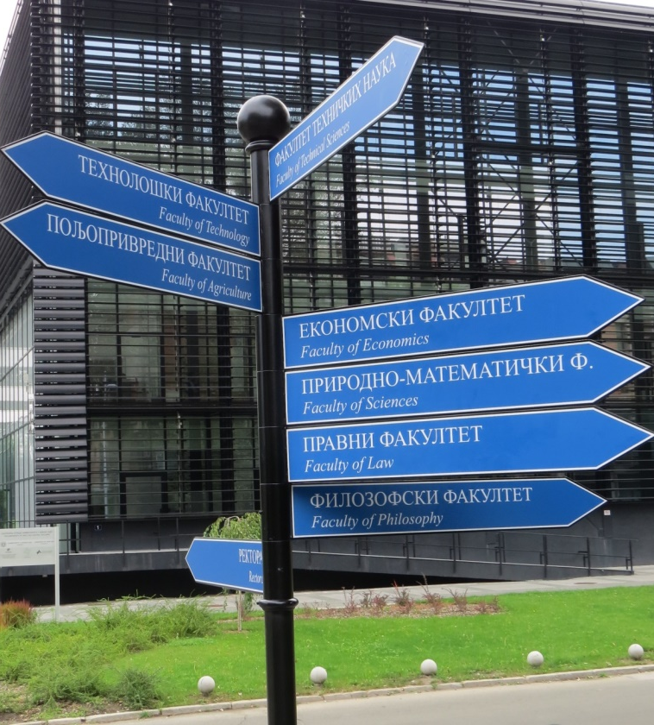
GENERAL INFORMATION
14 faculties
FACULTY OF PHILOSOPHY in Novi Sad
FACULTY OF AGRICULTURE in Novi Sad
FACULTY OF LAW in Novi Sad
FACULTY OF TECHNOLOGY in Novi Sad
FACULTY OF ECONOMICS in Subotica
FACULTY OF TECHNICAL SCIENCES in Novi Sad
FACULTY OF MEDICINE in Novi Sad
FACULTY OF SCIENCES in Novi Sad
ACADEMY OF ARTS in Novi Sad
FACULTY OF CIVIL ENGINEERING in Subotica
“MIHAJLO PUPIN” TECHNICAL FACULTY in Zrenjanin
FACULTY OF SPORT AND PHYSICAL EDUCATION in Novi Sad
FACULTY OF EDUCATION in Sombor
TEACHER TRAINING FACULTY IN THE HUNGARIAN LANGUAGE in Subotica
Strengthening of master curricula in water resources management
for the Western Balkans HEIs and stakeholders
www.swarm.ni.ac.rs

Slide 9
GENERAL INFORMATION
Scientific Institutes
Institute of Lowland Forestry and Environment , Novi Sad
Scientific Institute of Food Technology, Novi Sad
________________
BioSense Institute (originally formed within the Faculty of Technical Sciences)
Proclaimed by the European Union as one of the 30 research institutions in Europe with the greatest potential in the field of biotechnologies. In 2016, BioSense Institute's project ANTARES ranked first in the most competitive call of the European Commission (Horizon 2020 – Teaming) and provided 28 million euros as an investment into Serbian Science.
Interdisciplinary Studies and Research
Association of Centres for Interdisciplinary and Multidisciplinary Studies and Research – ACIMSI
University Centre for Applied Statistics
UNESCO Chair for Entrepreneurial Studies
Centre for Strategic and Advanced Studies
Strengthening of master curricula in water resources management
for the Western Balkans HEIs and stakeholders
www.swarm.ni.ac.rs

Slide 10
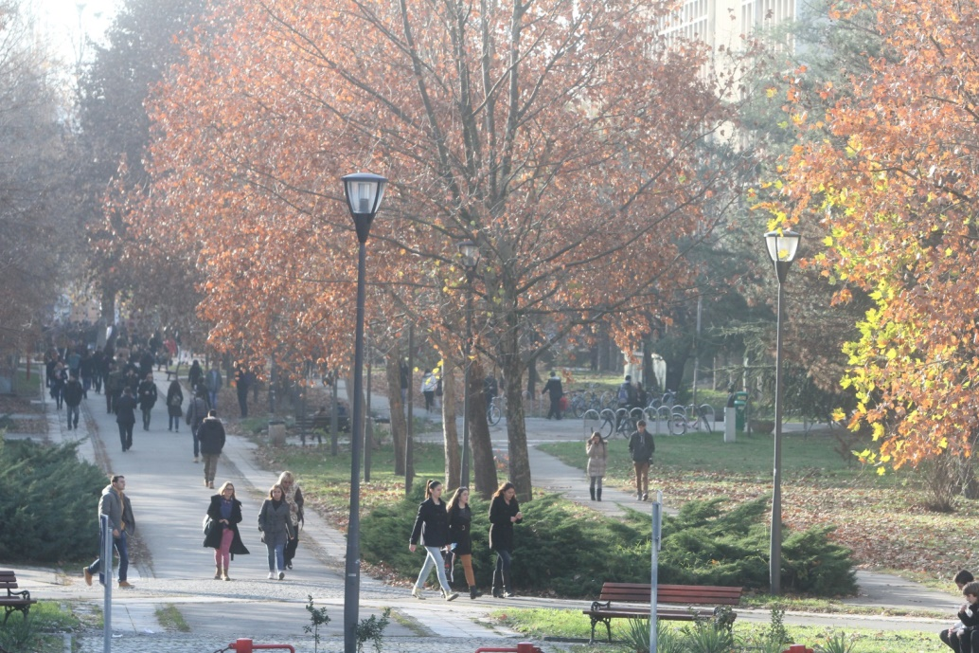
GENERAL INFORMATION
Central University Campus
Faculties
Sport fields
Student restaurants
Student dormitories
Institute for Student Health Care
___________________________________
The Central University Campus is located on the banks of the Danube, in the vicinity of the famous Petrovaradin Fortress, built in the XVIII century, and the city centre.
Strengthening of master curricula in water resources management
for the Western Balkans HEIs and stakeholders
www.swarm.ni.ac.rs

Slide 11
STUDENTS
Strengthening of master curricula in water resources management
for the Western Balkans HEIs and stakeholders
www.swarm.ni.ac.rs

Slide 12
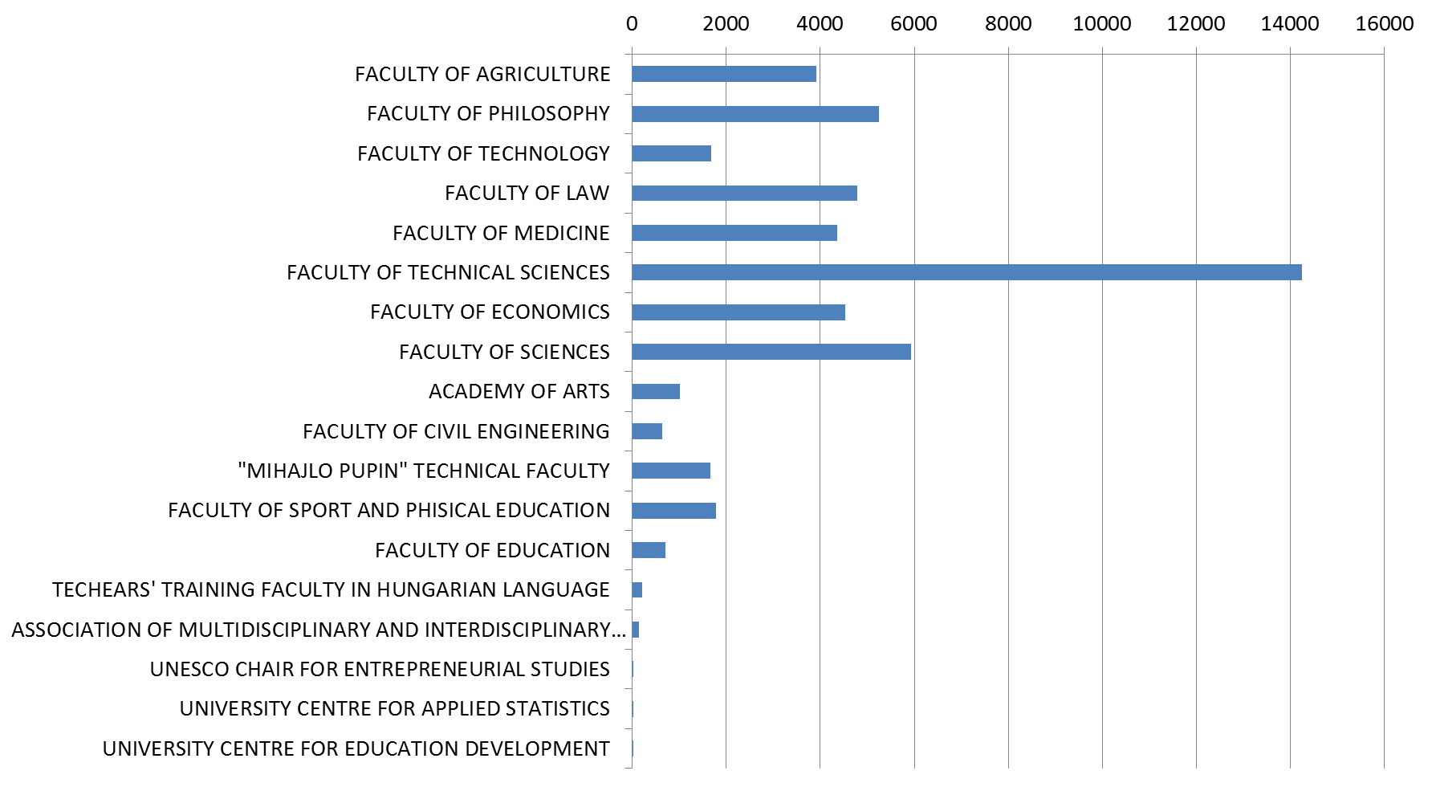
STUDENTS
Academic year 2016/2017.
Total
50,897
students
Strengthening of master curricula in water resources management
for the Western Balkans HEIs and stakeholders
www.swarm.ni.ac.rs

Slide 13
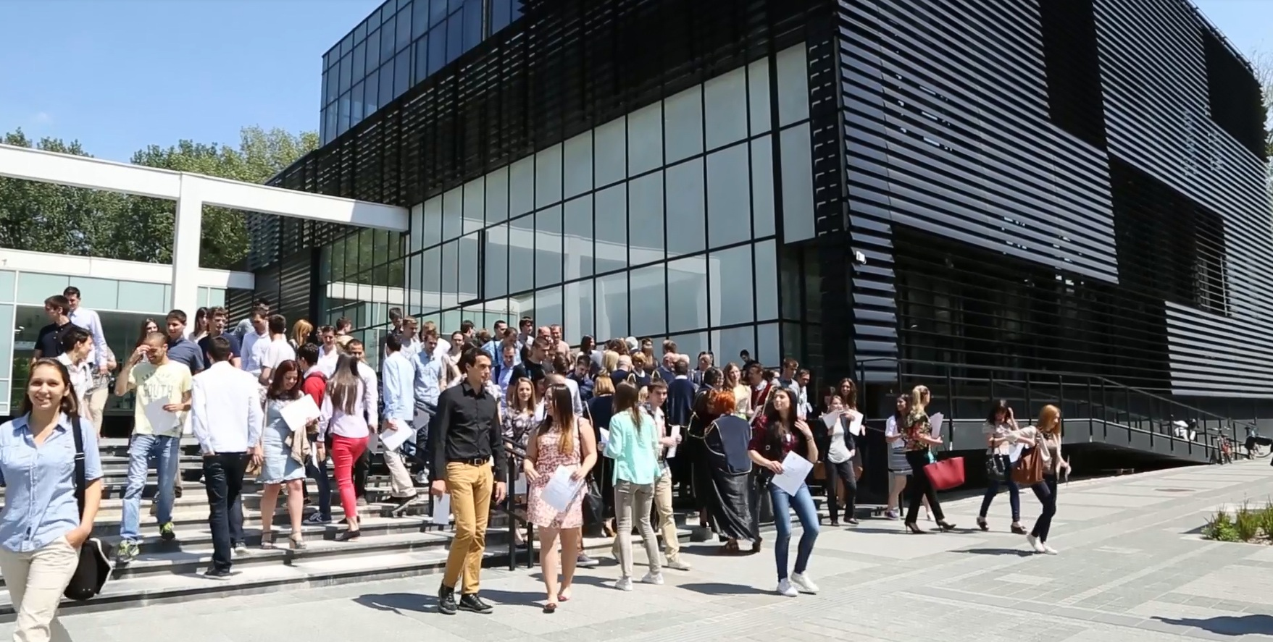
TEACHING AND RESEARCH STAFF
Strengthening of master curricula in water resources management
for the Western Balkans HEIs and stakeholders
www.swarm.ni.ac.rs

Slide 14
TEACHING AND RESEARCH STAFF
Academic year 2016/2017
Total
3,698
teachers, associates and researchers
Strengthening of master curricula in water resources management
for the Western Balkans HEIs and stakeholders
www.swarm.ni.ac.rs

Slide 15
RESEARCH AND KNOWLEDGE TRANSFER
Strengthening of master curricula in water resources management
for the Western Balkans HEIs and stakeholders
www.swarm.ni.ac.rs

Slide 16
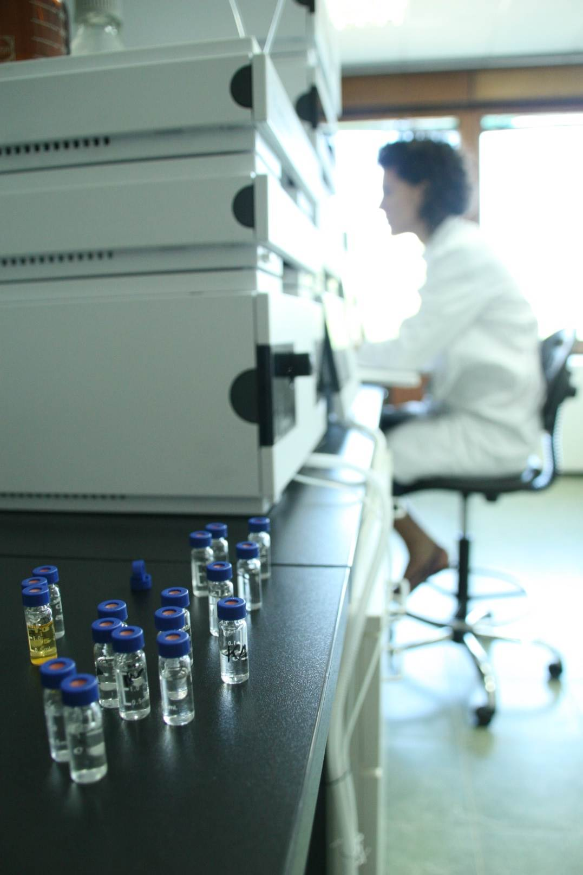
SCIENTIFIC POTENTIAL
Libraries at faculties and institutes
250 scientific laboratories
Scientific and research centres
Research groups
Networking
Innovation potential
Strengthening of master curricula in water resources management
for the Western Balkans HEIs and stakeholders
www.swarm.ni.ac.rs

Slide 17
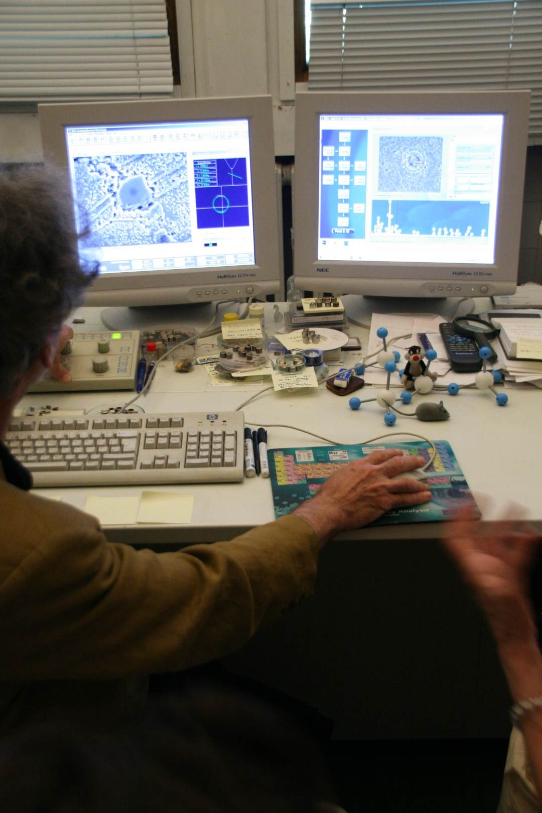
SCIENTIFIC AND OTHER PROJECTS
Fundamental research
Technological development projects
Integral and interdisciplinary research projects
All scientific and research fields: engineering and technology, natural sciences, medicine, social sciences, humanities and arts
International projects within the programmes: FP7, COST, EUREKA, SCOPES, SEE.ERA-NET, IPA, CEEPUS, TEMPUS, LLP, HORIZON 2020, TWINNING, CIP, ERASMUS MUNDUS, ERASMUS+, bilateral cooperation.
Strengthening of master curricula in water resources management
for the Western Balkans HEIs and stakeholders
www.swarm.ni.ac.rs

Slide 18
EXCELLENCE IN SCIENCE AND RESEARCH
Centres of Excellence at the University of Novi Sad
Accredited centres of excellence in the field of mathematics, vibro-acustics and biotechnology.
The BioSense Institute, originally formed within the Faculty of Technical Sciences, was proclaimed by the European Union as one of the 30 research institutions in Europe with the greatest potential in the field of biotechnologies. Its project ANTARES was best ranked in Europe in 2016 within the program Horizon 2020.
Strengthening of master curricula in water resources management
for the Western Balkans HEIs and stakeholders
www.swarm.ni.ac.rs

Slide 19
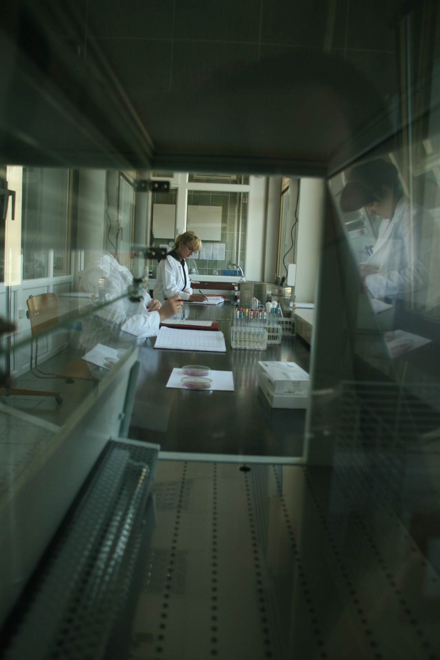
KNOWLEDGE TRANSFER
Around 140 start-up and spin-off companies founded
Mainly in the IT sector
Employing young engineers who graduated from the University of Novi Sad
Some of these companies implement projects for large international corporations and have contributed to Novi Sad becoming recognized internationally as a “Software Valley”.
Strengthening of master curricula in water resources management
for the Western Balkans HEIs and stakeholders
www.swarm.ni.ac.rs

Slide 20
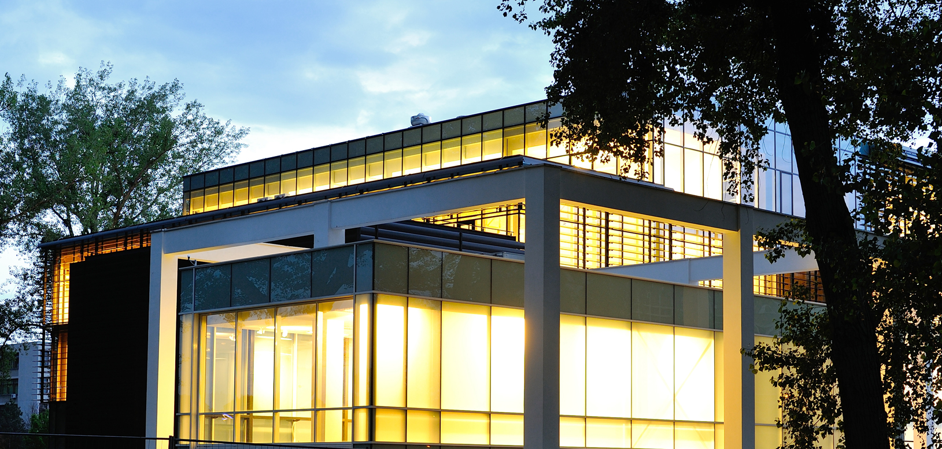
INVESTMENTS
Strengthening of master curricula in water resources management
for the Western Balkans HEIs and stakeholders
www.swarm.ni.ac.rs

Slide 21
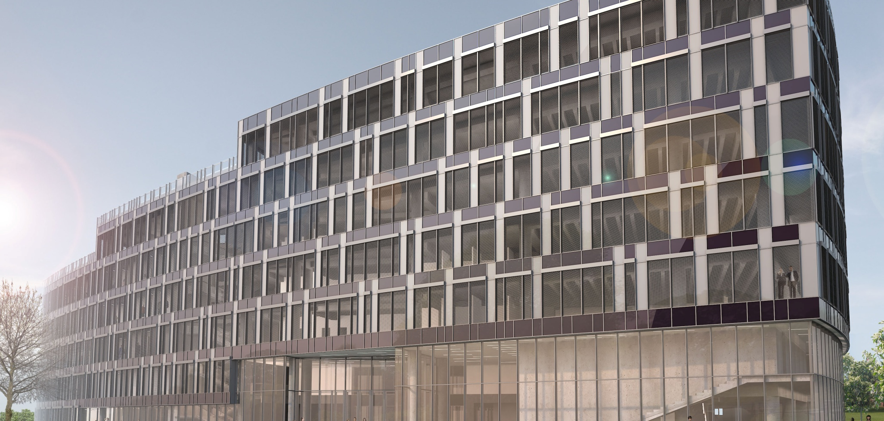
NEW SCIENTIFIC AND TECHNOLOGY PARK
Location: University Campus
PHASE 1:
Laboratories
/ done /
2,150 m²
PHASE 2:
Technology Park
/ under construction /
29,000 m²
Strengthening of master curricula in water resources management
for the Western Balkans HEIs and stakeholders
www.swarm.ni.ac.rs

Slide 22
INTERNATIONAL COOPERATION
Strengthening of master curricula in water resources management
for the Western Balkans HEIs and stakeholders
www.swarm.ni.ac.rs

Slide 23
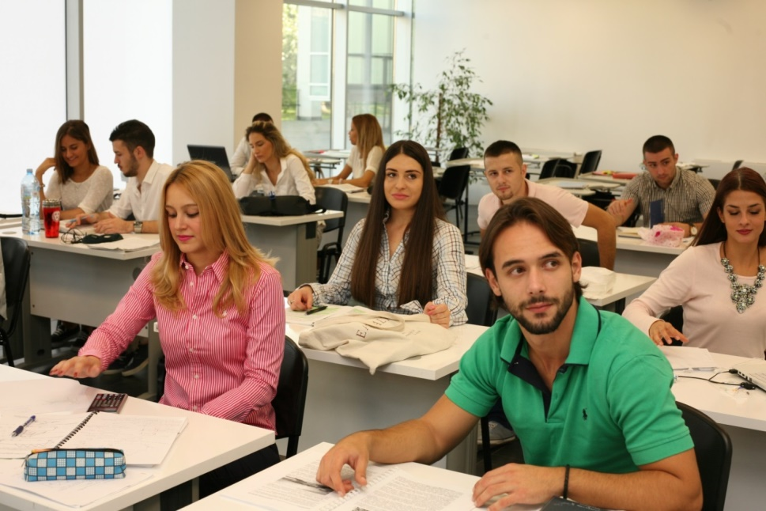
INTERNATIONAL COOPERATION
MEMBERSHIP IN THE INTERNATIONAL PROGRAMMES FOR THE MOBILITY OF STAFF AND STUDENTS
Erasmus+
Erasmus Mundus Action 2: Basileus V
Erasmus Mundus Action 2: JoinEU-SEE PENTA
Erasmus Mundus Action 2: SIGMA AGILE
Erasmus Mundus Action 2: ERAWEB
Erasmus Mundus Action 2: SUNBEAM
Campus Europae
CEEPUS
Ugrad
DAAD
Bilateral agreements
Strengthening of master curricula in water resources management
for the Western Balkans HEIs and stakeholders
www.swarm.ni.ac.rs

Slide 24
INTERNATIONAL COOPERATION
MEMBERSHIP IN INTERNATIONAL ASSOCIATIONS
EUA – European University Association
DRC – Danube Rectors’ Conference
IUC – Inter-University Center in Dubrovnik
EUF-CE – European University Foundation (Campus Europae)
CEEPUS – Central European Exchange Program for University Studies
BUN – Balkan Universities Network
ACRU - Association of Carpathian Region Universities
UniAdrion – Virtual University of the Adriatic-Ionian Basin
ALADIN – ALpe ADria INitiative Universities’ Network
CASEE-ICA – The ICA Regional Network for Central and South Eastern Europe
AEC – Association Européenne des Conservatoires, Académies de Musique et Musikhochschulen
ELIA - European League of Institutes of the Arts
The University of Novi Sad has been selected in September 2017 as the new headquarters of the Secretariat of the Higher Education Institutions Consortium of China and 16 Central and Eastern European Countries in the framework of 16+1 Mechanism, coordinating the Consortium activities together with the permanent Secretariat whose headquarters are in China.
Strengthening of master curricula in water resources management
for the Western Balkans HEIs and stakeholders
www.swarm.ni.ac.rs

Slide 25
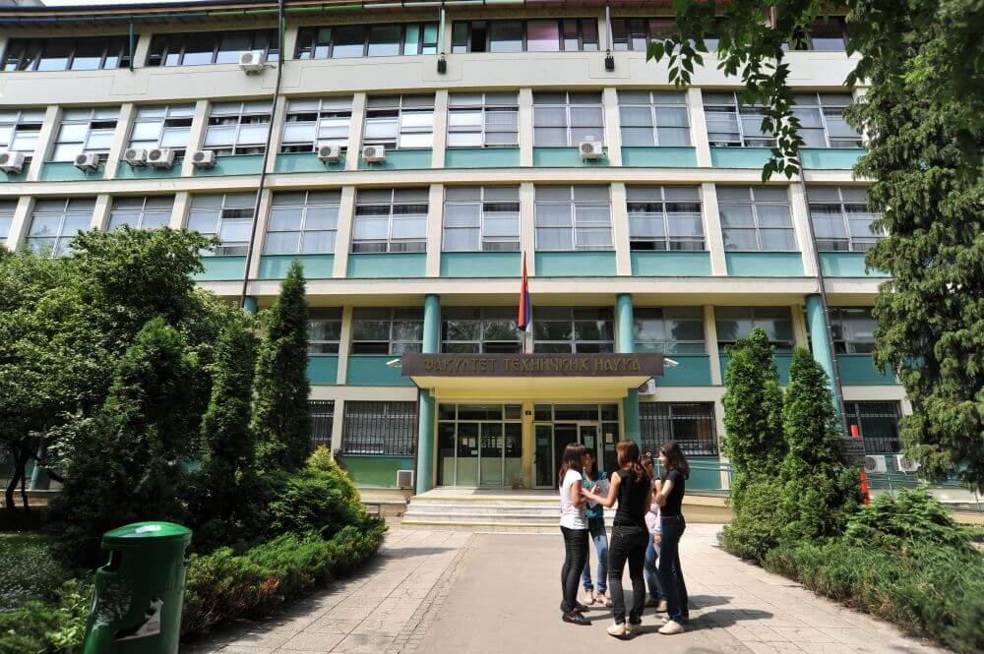
FACULTY OF TECHNICAL SCIENCES
Strengthening of master curricula in water resources management
for the Western Balkans HEIs and stakeholders
www.swarm.ni.ac.rs

Slide 26
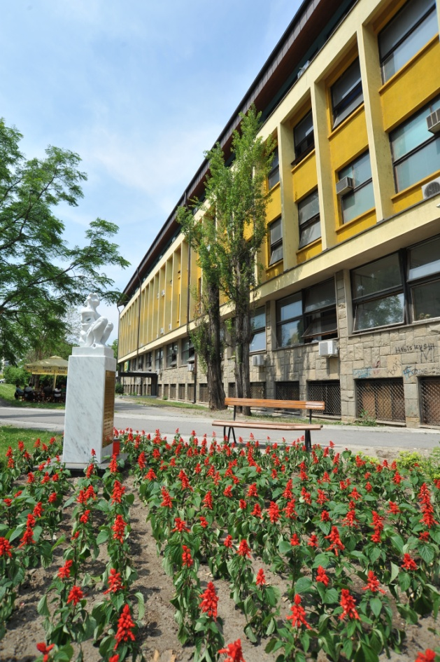
FACULTY OF TECHNICAL SCIENCES
It was founded on 18th May 1960 as the Faculty of Mechanical Engineering.
Faculty is accredited for conducting educational activities on 90 study programs, most of these programs are accredited in English.
Faculty comprises 13 departments, 10 administrative units and 33 research centers.
Faculty counts over 14,000 students.
Strengthening of master curricula in water resources management
for the Western Balkans HEIs and stakeholders
www.swarm.ni.ac.rs

Slide 27
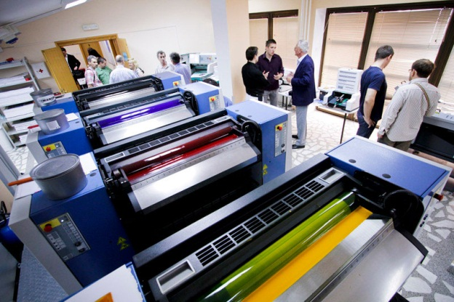
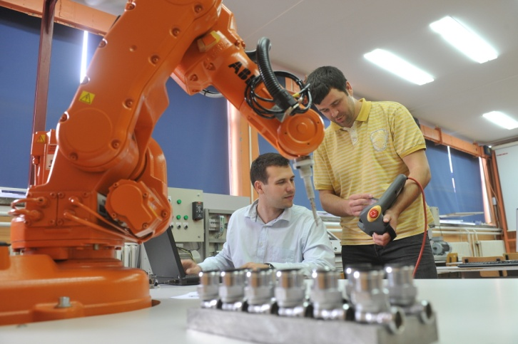
FACULTY OF TECHNICAL SCIENCES
Departments:
Production Engineering
Mechanization and Design Engineering
Energy and Process Engineering
Technical Mechanics
Power, Electronic and Telecommunication Engineering
Computing and Control Engineering
Civil Engineering and Geodesy
Traffic Engineering
Architecture and Urban Planning
Industrial Engineering and Management
Graphic Engineering and Design
Environmental Engineering and Occupational Safety Engineering
Fundamental disciplines in Engineering
Strengthening of master curricula in water resources management
for the Western Balkans HEIs and stakeholders
www.swarm.ni.ac.rs

Slide 28
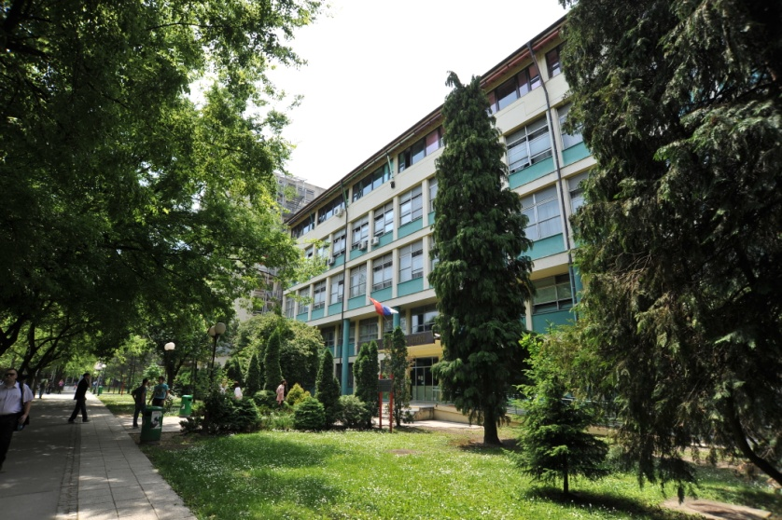
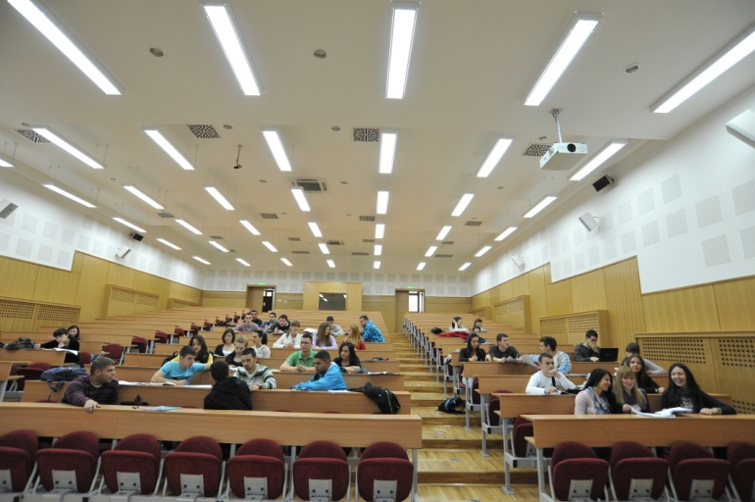
FACULTY OF TECHNICAL SCIENCES
The activities of the Faculty of Technical Sciences are threefold:
education,
research and development,
applied research.
The Faculty of Technical Sciences offers education in four areas:
technology and engineering,
science and mathematics,
social sciences and
arts and fine arts.
Strengthening of master curricula in water resources management
for the Western Balkans HEIs and stakeholders
www.swarm.ni.ac.rs

Slide 29
FACULTY OF TECHNICAL SCIENCES
Academic studies are organized as:
Undergraduate academic studies (1st cycle studies)
last for 4 years (at least 240 ECTS)
Master academic studies (2nd cycle studies)
depending on the study program last for 1 year (at least 60 ECTS) or 2 years (120 ECTS)
Specialist academic studies (2nd cycle studies)
last for 1 year (at least 60 ECTS) or 1.5 year (worth 90 ECTS)
Doctoral academic studies (3rd cycle studies)
last for 3 years and are worth at least 180 ЕСTS
Strengthening of master curricula in water resources management
for the Western Balkans HEIs and stakeholders
www.swarm.ni.ac.rs

Slide 30
FACULTY OF TECHNICAL SCIENCES
Professional studies are organized as:
Undergraduate professional studies - (1st cycle studies)
last for 3 years (at least 180 ECTS)
Specialist professional studies (2nd cycle studies)
last for 1 or 2 years and are worth at least 60 to 120 ECTS
International professionally oriented master studies (2nd cycle studies) Master of Business Administration – МBA
last for 2 years and are worth at least 120 ЕСTS
Strengthening of master curricula in water resources management
for the Western Balkans HEIs and stakeholders
www.swarm.ni.ac.rs

Slide 31
FACULTY OF TECHNICAL SCIENCES
Scientific and Research Activities
90 international projects (TEMPUS, CEEPUS, WUS, CARDS, FP7, EUREKA!, COST, H2020, ERASMUS+)
120 national scientific projects financed by the Ministry of Education, Science and Technological Development of the Republic of Serbia and the Provincial Secretariat for Higher Education and Scientific Research of the Autonomous Province of Vojvodina.
The Faculty publishes 7 international journals and organizes 16 scientific and professional conferences on various aspects of engineering.
Strengthening of master curricula in water resources management
for the Western Balkans HEIs and stakeholders
www.swarm.ni.ac.rs

Slide 32
FACULTY OF TECHNICAL SCIENCES
BILATERAL COOPERATION
Ministry of Education, Science and Technological Development contracts and financially supports projects of scientific and technological cooperation between domestic and foreign scientific and research organizations (NIO) on the basis of international bilateral agreements.
15 active projects
CEEPUS
"Central European Exchange Program for University Studies“
23 active projects
Strengthening of master curricula in water resources management
for the Western Balkans HEIs and stakeholders
www.swarm.ni.ac.rs

Slide 33
FACULTY OF TECHNICAL SCIENCES
COST
The longest-running European framework supporting trans-national cooperation among researchers, engineers and scholars across Europe.
13 active projects
ERASMUS +
Capacity-building projects in the field of higher education
6 active projects
Strengthening of master curricula in water resources management
for the Western Balkans HEIs and stakeholders
www.swarm.ni.ac.rs

Slide 34
FACULTY OF TECHNICAL SCIENCES
EUREKA
A publicly-funded, intergovernmental network, involving over 40 countries
1 active project
FP7
The Seventh Framework Programme of the European Community for research, technological development and demonstration activities
7 active projects
Strengthening of master curricula in water resources management
for the Western Balkans HEIs and stakeholders
www.swarm.ni.ac.rs

Slide 35
FACULTY OF TECHNICAL SCIENCES
HORIZON 2020
The biggest EU Research and Innovation programme
3 active projects
SCOPES
Scientific co-operation between Eastern Europe and Switzerland
1 active project
TEMPUS
A European Union programme designed to help the process of higher education reform in Partner Countries.
4 active projects
Strengthening of master curricula in water resources management
for the Western Balkans HEIs and stakeholders
www.swarm.ni.ac.rs

Slide 36
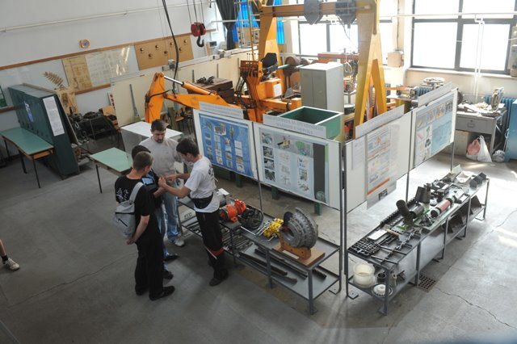
FACULTY OF TECHNICAL SCIENCES
Applied Research
Over 200 contracts are annually signed by the Faculty of Technical Sciences related to the transfer of its scientific research into Industry.
The Faculty is the founder of more than 110 companies.
Strengthening of master curricula in water resources management
for the Western Balkans HEIs and stakeholders
www.swarm.ni.ac.rs

Slide 37
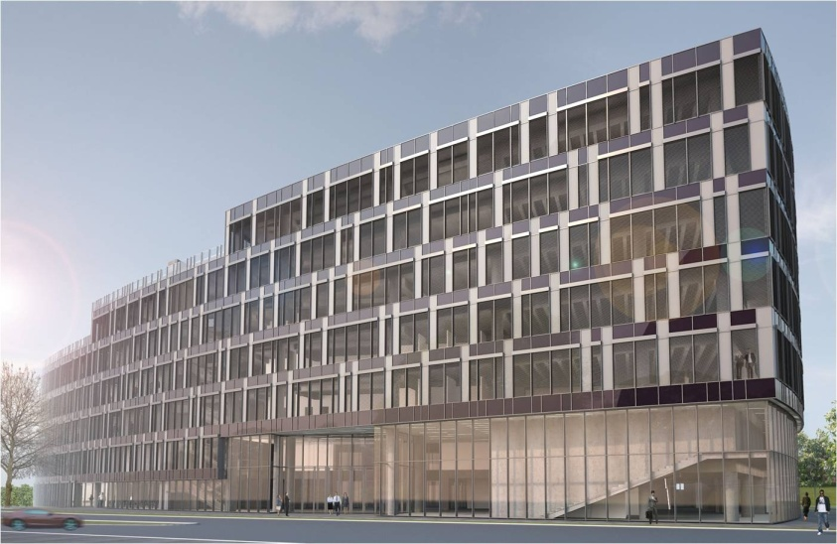
FACULTY OF TECHNICAL SCIENCES
Our key words for the future are:
QUALITY
EFFICIENCY and
MULTIDISCIPLINARITY
Strengthening of master curricula in water resources management
for the Western Balkans HEIs and stakeholders
www.swarm.ni.ac.rs

Slide 38
Water Treatment and Protection Engineering
Strengthening of master curricula in water resources management
for the Western Balkans HEIs and stakeholders
www.swarm.ni.ac.rs

Slide 39
Water Treatment and Protection Engineering
The study program Water Treatment and Protection Engineering was developed as new, up-to-date, postgraduate curricula as a part of TEMPUS project titled as Development of Environmental and Resources Engineering Learning (acronym DEREL) Environment and Resources Engineering at the following Universities:
University of Novi Sad, Serbia,
Ss. Cyril and Methodius University in Skopje, FYR of Macedonia and
Polytechnic University of Tirana, Albania.
It is based on the European Credit Transfer System and in accordance with the Bologna Process, following the criteria and conditions for setting up a Double Postgraduate Degree.
Strengthening of master curricula in water resources management
for the Western Balkans HEIs and stakeholders
www.swarm.ni.ac.rs

Slide 40
Water Treatment and Protection Engineering
It is a Master academic study at the Department of Environmental Engineering and Occupational Safety and Health, Faculty of Technical Sciences, University of Novi Sad.
The acquired academic degree is Master in Engineering of Water Treatment and Protection.
It is a two year master study program with 120 ECTS.
The Master Program "Water Treatment and Protection Engineering" enables the students to concretize and expand their knowledge concerning waste water treatment. It allows understanding the basic principles of engineering in various fields of environment protection, acquiring additional expertise for the implementation of modern technical systems, gaining ability for knowledge integration to be applied in any particular case, ensuring them to be engaged in independent research and creative work during realization of the curriculum.
The curriculum Water Treatment and Protection Engineering is developed in response to the needs of the industry, business and institutions, which have to face environmental problems and ask for engineers with interdisciplinary expertise in the field of environmental engineering and water treatment and protection.
Strengthening of master curricula in water resources management
for the Western Balkans HEIs and stakeholders
www.swarm.ni.ac.rs

Slide 41
Water Treatment and Protection Engineering
No. | Accredited | ECTS
First year
1 | Statistical and numerical methods | 9
2 | Elective course | 5
 | Hydrotechnics and hydromechanics - fundamentals
 | Environmental Protection in Energy Production
 | Sources and Environmental pollution
3 | Elective course | 5
 | Hydrometry
 | Environmental Transport Processes
 | Basic biological principles in the environmental protection
 | Chemistry of Water, Air and Soil Pollution
4 | Elective course | 6
 | Environmental system analysis
 | Automation in Environmental Processes
 | Hydraulic constructions – design and protection
5 | Technological processes in the water quality control | 7
6 | Management of environmental protection systems | 5
7 | Hazards and the environment | 9
8 | Renewable Energy Technologies | 6
9 | Fluvial Hydraulics | 8
 | TOTAL ECTS – First year | 60
Strengthening of master curricula in water resources management
for the Western Balkans HEIs and stakeholders
www.swarm.ni.ac.rs

Slide 42
Water Treatment and Protection Engineering
No. | Accredited | ECTS
Second year
10 | Elective course | 4
 | Advanced Sanitary Engineering
 | Solid Waste Management
 | Monitoring and Management of systems
11 | Design of water treatment plant processes | 5
12 | Design of wastewater treatment plant processes | 5
13 | River Basin Management | 5
14 | Elective course | 4
 | Geotechnics - fundamentals
 | Environmental Economics
 | Environmental Risk Management
15 | Environmental Impact Assessment and Management | 4
16 | Practice | 3
17 | Research on theoretical basis of Master thesis | 15
18 | Master thesis | 15
 | TOTAL ECTS – Second year | 60
Strengthening of master curricula in water resources management
for the Western Balkans HEIs and stakeholders
www.swarm.ni.ac.rs

Slide 43
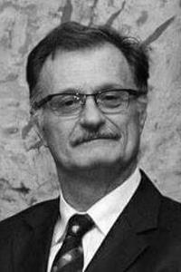
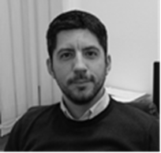
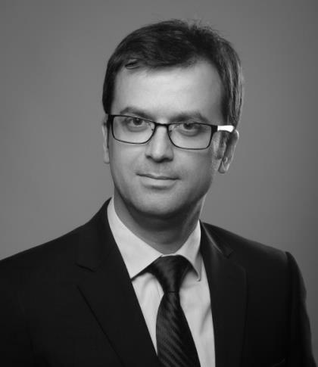
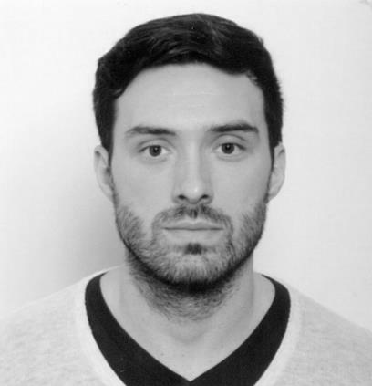
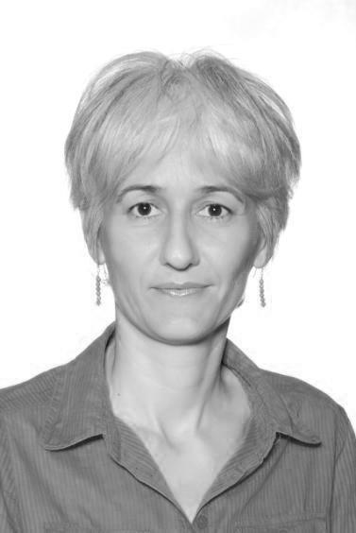
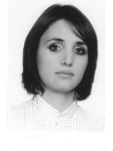
SWARM TEAM - UNS
Igor Peško
Nemanja Stanisavljević
Srđan Kolaković
Dejan Ubavin
Slobodan Kolaković
Vesna Mašulović
Dragana Vujović
Strengthening of master curricula in water resources management
for the Western Balkans HEIs and stakeholders
www.swarm.ni.ac.rs

Slide 44
Thank you for your attention
Strengthening of master curricula in water resources management
for the Western Balkans HEIs and stakeholders
www.swarm.ni.ac.rs

